Slide 1
The Perfect Batch
Hailey Skoglund, Gus Lipkin, & Cookie Monster

Slide 2
Literature review

Slide 3
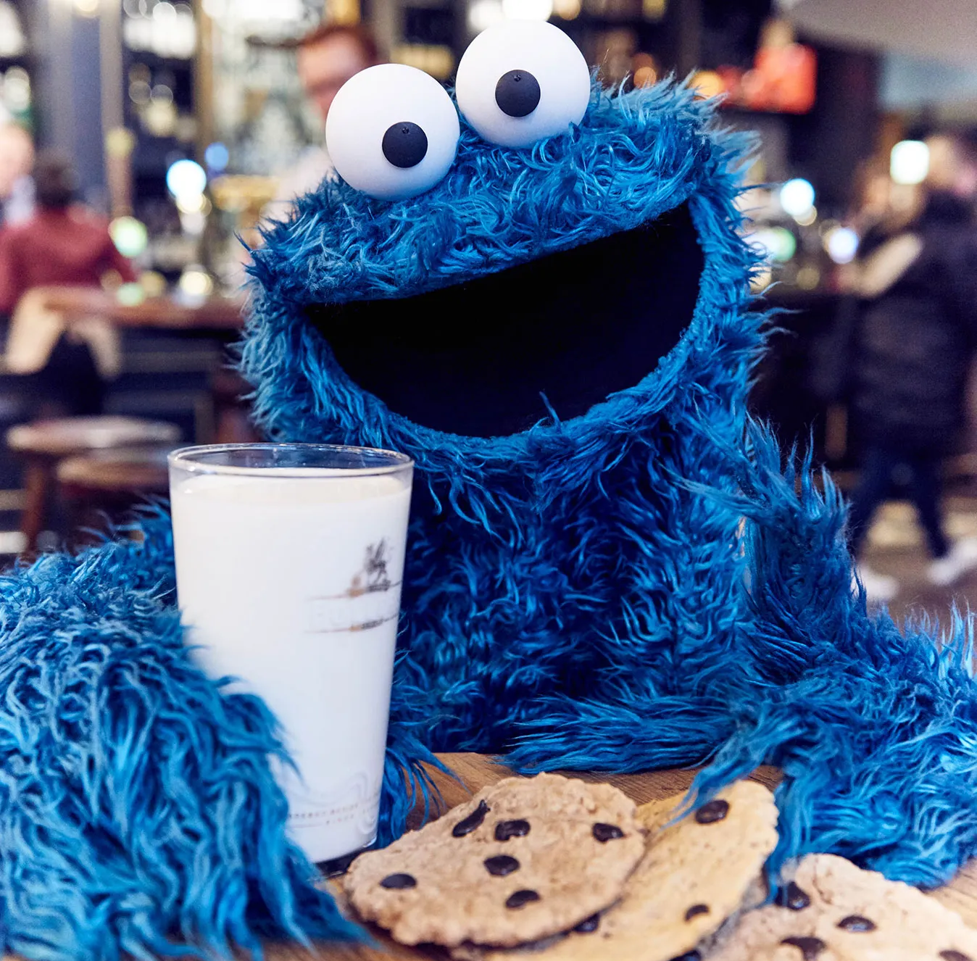
“Sometimes me think, what is friend? And then me say, friend is someone to share the last cookie with.”
– Cookie Monster

Slide 4
Principle 6: “Build a culture of stopping to identify out-of-standard conditions and build in quality”
Make sure the cookie dough tastes good
If a cookie looks funny, eat it
If a cookie looks too good, eat it
Make sure the cookies you bring to share are the most average cookies
Give the burnt cookies to people you don’t like

Slide 5
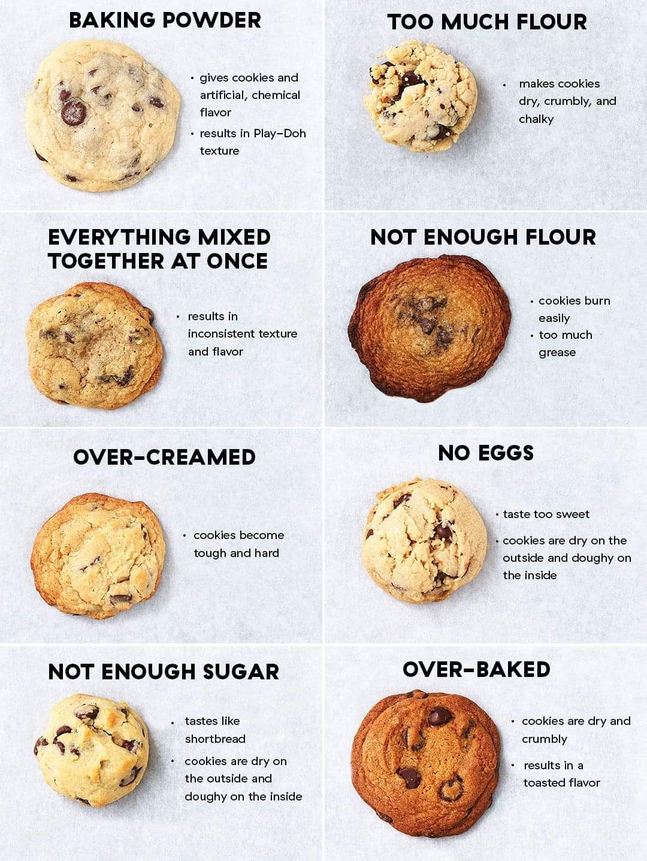
Principle 7: “Use visual control to support people in decision-making and problem solving”

Slide 6



Principle 8: “adopt and adapt technology that supports your people and processes”

Slide 7
Choosing a store

Slide 8

Store Distances

Slide 9
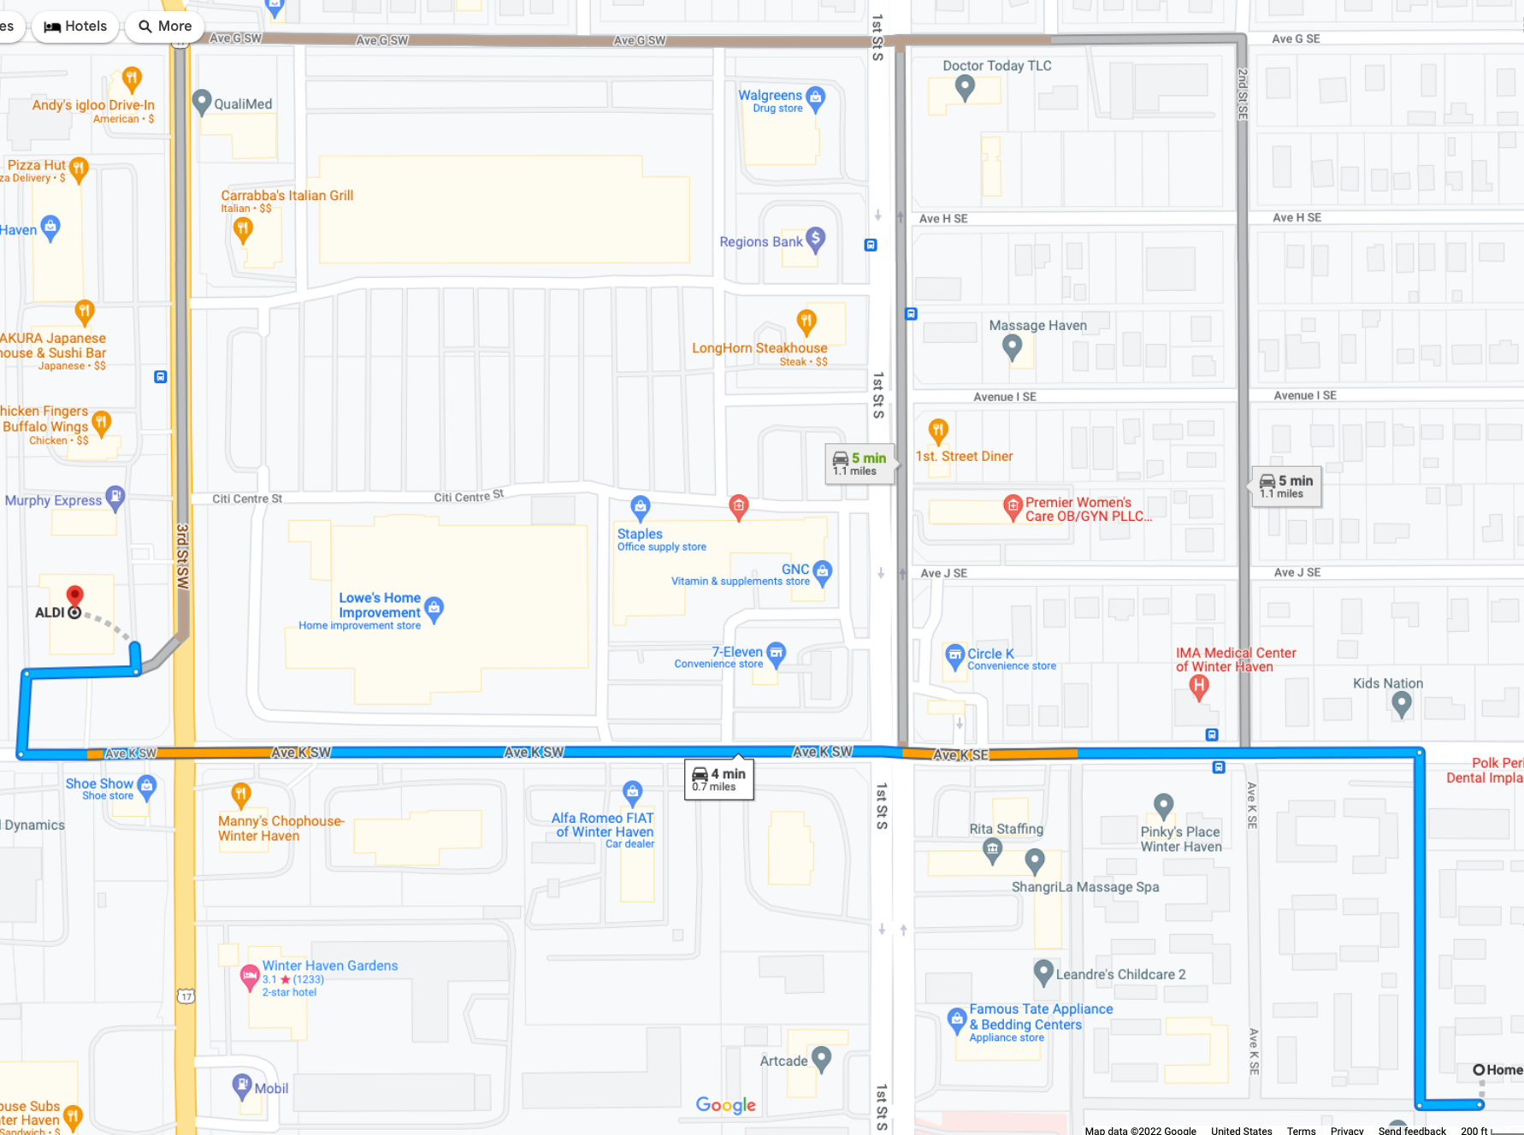
Aldi
– 3 routes
– Shortest: 4 min, .7 mile
– Longest: 5 min, 1.1 mile

Slide 10
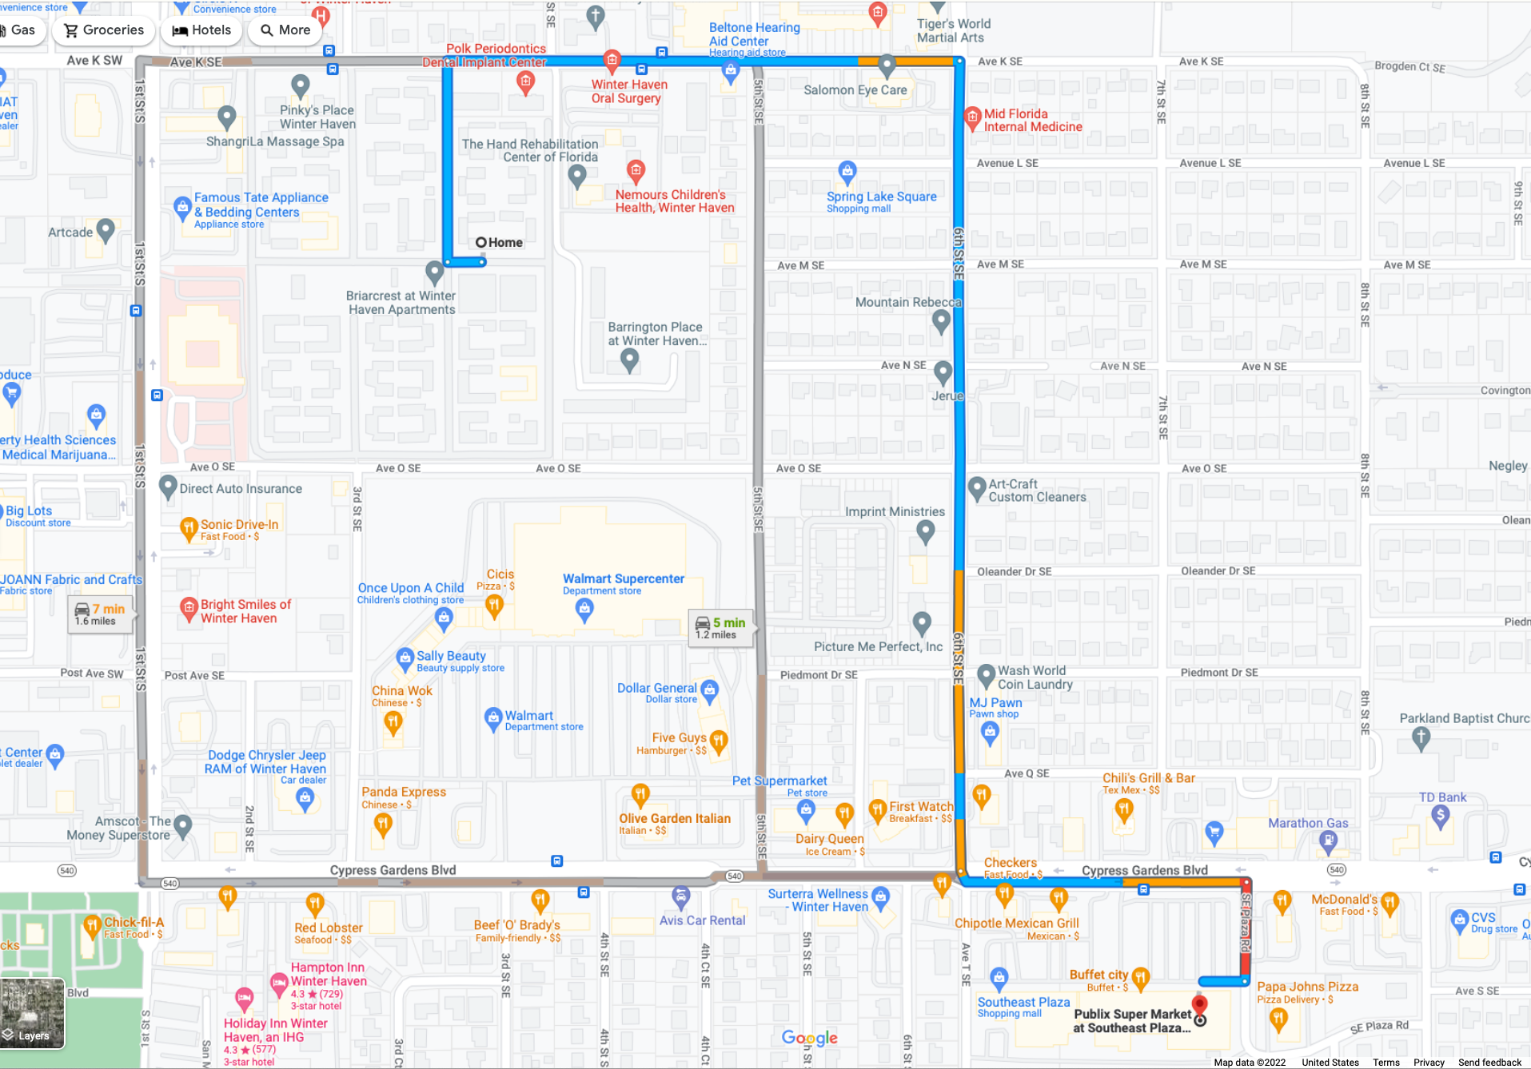
Publix
– 3 routes
– Shortest: 5 min, 1.2 mile
– Longest: 7 min, 1.6 mile

Slide 11
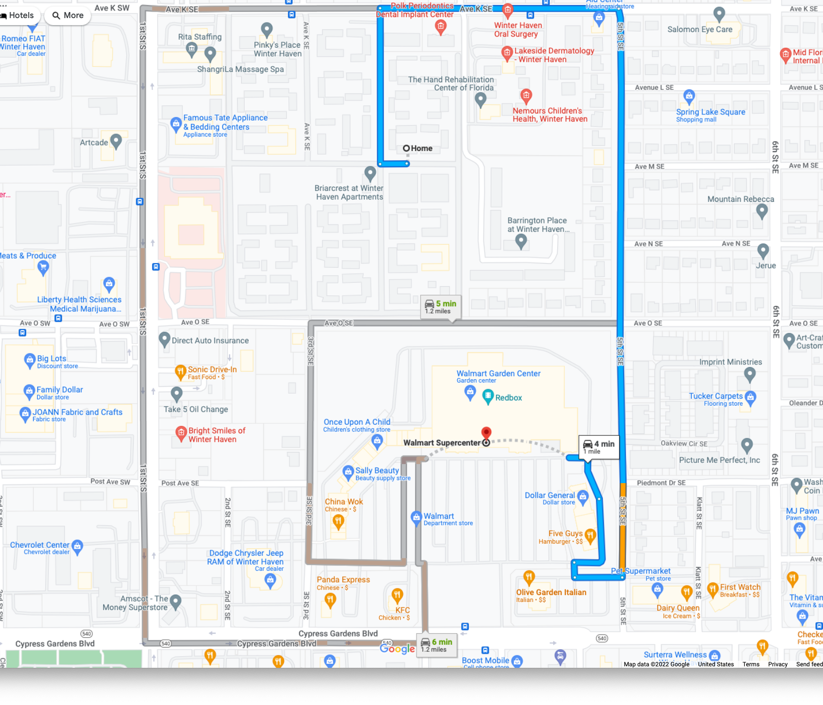
Walmart
– 3 routes
– Shortest: 4 min, 1 mile
– Longest: 6 min, 1.2 mile

Slide 12
Store Prices

Slide 13
Aldi

Slide 14
Publix

Slide 15
Walmart

Slide 16
Store Decision

Slide 17
Organizing the cooking space

Slide 18




1. Remove cat from Table

Slide 19




2. Gather equipment

Slide 20
3. Organize equipment

Slide 21







4. Gather the ingredients

Slide 22
5. Sort the ingredients

Slide 23
6. Set the ingredients in order

Slide 24
7. Shine? 8. Standardize 9. Sustain

Slide 25
Optimizing cookie production

Slide 26

1. Preheat the oven

Slide 27
2. While preheating, mix ingredients

Slide 28

3. Prepare first batch

Slide 29

4. Put cookies in oven

Slide 30
5. While cookies are Baking (10 min), prepare next batch

Slide 31


6. Remove cookies from oven, place new batch in oven, allow cookies to cool (10 min)

Slide 32
7. Repeat steps 5 and 6

Slide 33
Precedence chart

Slide 34
Math ☹
Hourly Output |  | Takt Time |  | Minimum Workstations |  | Efficiency
72 |  | 37.5 |  | 2 |  | 66.66%
Daily Output |  | Bottleneck Output |  |  |  | Balance Delay
576 |  | 240 |  |  |  | 33.33%
Total project time: 120 Minutes

Slide 35
Quality control

Slide 36
Sample the cookies

Slide 37
Sample More cookies

Slide 38
Sample More cookies

Slide 39
Leave a few cookies in the fridge so you can say you didn’t eat all of them

Slide 40
Conclusion

Slide 41
“10/10, best cookies ever”
– Cookie Monster

Slide 42
The Perfect Batch
Hailey Skoglund, Gus Lipkin, & Cookie Monster

